Slide 1

Detecting Phishing Websites
Ainakota Yaswanth
Bandapu sai chandu
Dachepally kiran kumar
Vinta anshitha

Slide 2
Problem Statement
Abstract
Existing system
Contents
Adapted system
Literature Review
Feature Categorization
Results
Future Scope and Conclusion

Slide 3
Abstract
Data phishing has emerged as a prevalent and successful method employed by cybercriminals to deceive individuals and illicitly obtain their personal and financial information. In our increasingly internet-dependent world, where we conduct a significant portion of our daily activities online, fraudsters have found a fertile ground to execute targeted phishing attacks. These modern-day phishing attempts have become remarkably sophisticated, making them harder to detect. Astonishingly, a recent study conducted by Intel revealed that an overwhelming 97% of security experts failed to differentiate between genuine emails and phishing emails. This alarming statistic underscores the urgent need for a deeper understanding of data phishing and the implementation of robust countermeasures to safeguard ourselves from these insidious attacks.

Slide 4
Problem statement
Develop a data science model to detect phishing websites accurately, aiming to protect users from online threats. The model should analyse various features of a website and classify it as either legitimate or phishing. Providing a reliable tool for online security and fraud detection

Slide 5
Types of Phishing
Email Phishing
Spear Phishing
Smishing and Vishing
Search Engine Phishing
Internet Phishing

Slide 6
Existing System
Rule Based System
Machine Learning Systems
Hybrid Approaches
Blacklist/Whitelist Sytem
Collaborative Filtering

Slide 7
Adapted System
Machine Learning Model
Machine learning models are computer programs that are used to recognize patterns in data or make predictions. Machine learning models are created from either labelled, unlabelled, or mixed data.

Slide 8
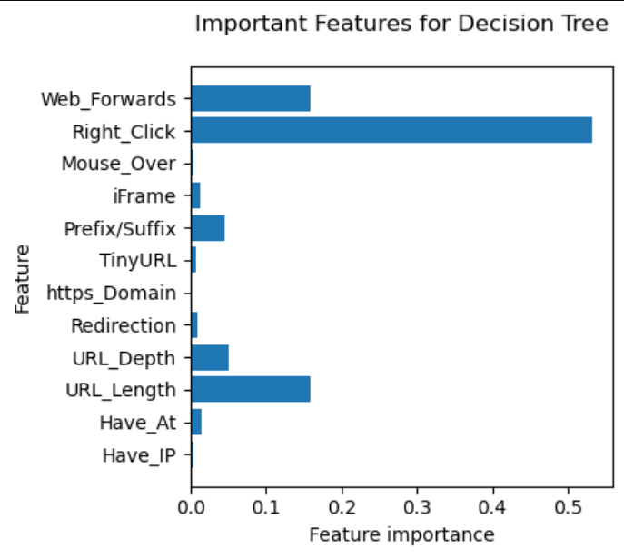
Decision Tree Algorithm
Models for classification and regression tasks frequently use decision trees. In essence, they pick up a hierarchy of if/else questions that lead to a choice. Finding the if/else set of questions that leads us to the correct solution the quickest is the key to understanding how to use a decision tree

Slide 9
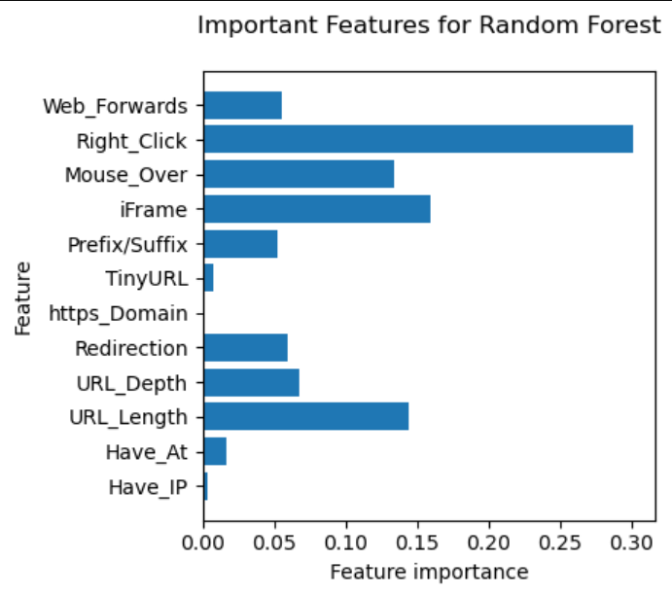
Random Forest Algorithm
Random forest is a group of decision trees, where each tree differs somewhat from the others. The theory behind random forests is that while each tree may make somewhat accurate predictions, it will probably overfit on some portions of the data. They are quite effective, frequently operate well without much parameter adjusting, and don't call for data scaling.

Slide 10
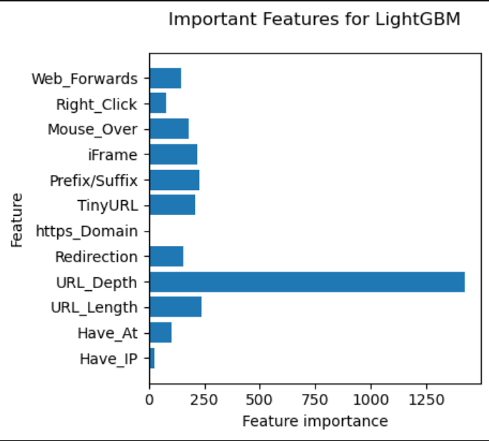
LightGBM
Python's LightGBM is a powerful gradient boosting method. It employs a leaf-wise tree growth strategy, which, in comparison to conventional gradient boosting techniques, provides quicker training times and greater accuracy. LightGBM was created with the explicit purpose of handling huge datasets well while maximising memory consumption. To further improve its efficiency, it includes elements like parallel computation and categorical variable support

Slide 11
Support Vector Machine(SVM)
Support-vector machines (SVMs, also known as support-vector networks) are supervised learning models with corresponding learning algorithms that examine data used for regression analysis and classification.
An SVM training method creates a model that categorises fresh examples according to one of two categories given a series of training examples that have each been tagged as belonging to one of the categories. This makes the algorithm a non-probabilistic binary linear classifier.

Slide 12
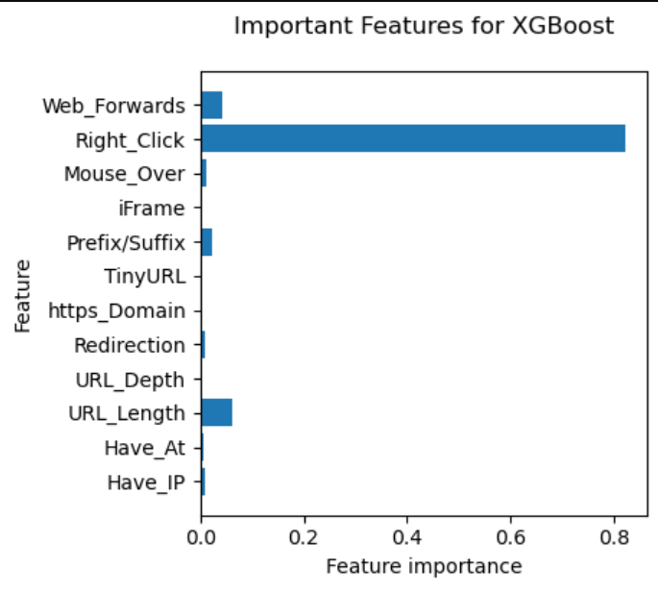
Extreme Gradient Boost
XGBoost is an optimized distributed gradient boosting library designed to be highly efficient, flexible and portable. It implements machine learning algorithms under the Gradient Boosting framework. XGBoost provides a parallel tree boosting (also known as GBDT, GBM) that solve many data science problems in a fast and accurate way. The same code runs on major distributed environment (Hadoop, SGE, MPI) and can solve problems beyond billions of examples.

Slide 13
Naïve Bayes
Naive Bayes is a simple and popular machine learning algorithm used for classification tasks. It assumes that features are independent and calculates the probability of a class given the feature values. It is easy to implement and performs well on large datasets. Despite its simplifying assumptions, Naive Bayes can be surprisingly accurate and is widely used for spam filtering, text classification, and other applications.

Slide 14
Literature Review
Detection of Phishing Websites Using Machine Learning | https://jpinfotech.org/detection-of-phishing-websites-using-machine-learning/
An effective detection approach for phishing websites using URL and HTML features | https://www.ieeexpert.com/python-projects/phishing-website-detection-using-machine-learning/

Slide 15
Feature categorization
Address-Based / URL-Based
HTML & JavaScript Based

Slide 16
URL-Based
URL-based detection of phishing websites involve analysing the characteristics of a URL to determine if it is likely to be associated with a phishing attempt. It focuses on examining specific features within URL, such as domain name, subdomains, length, presence of suspicious keywords, use of special characters, and similarity to legitimate websites.
URL-based detection serves as an initial line of defence against phishing attacks, enabling the identification and blocking of potentially harmful URLs before user interaction.
From the dataset:-
Domain of URL
IP Address in URL
"@" Symbol in URL
Length of URL
Depth of URL
Redirection "//" in URL
"http/https" in Domain name
Using URL Shortening Services “TinyURL”
Prefix or Suffix "-" in Domain

Slide 17
HTML & JavaScript based Features
HTML and JavaScript-based features are utilized in the detection of phishing websites by analyzing the structure, content, and behaviour of web pages. This technique involves examining HTML elements, tags, and attributes, as well as JavaScript code, to identify suspicious or malicious patterns. Phishing websites may employ techniques such as hidden form fields, fake login forms, or scripts that redirect users to fraudulent pages. By analysing these HTML and JavaScript-based features, security systems can detect anomalies and indicators of phishing activity, allowing for timely identification and mitigation of potential threats.
From the dataset:-
iFrame Redirection
Status Bar Customization
Disabling Right Click
Website Forwarding

Slide 18
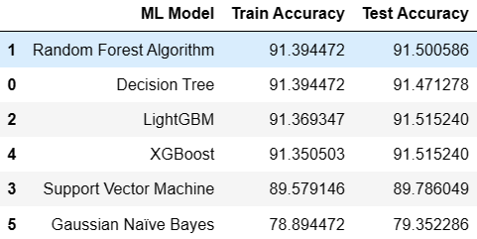
Results
The models are evaluated, and considered metric is accuracy.
Bellow figure shows the training and test dataset accuracy by the respective models :-
From the above image it is clear that Random Forest model gives better performance. The model is saved for further usage.

Slide 19
Future Scope and Conclusion
The accuracy rating received is regarded as a good performance. However, whether it is regarded as ideal or not depends on a number of variables, including the problem's complexity, the data at hand, and the desired level of accuracy. Consequently, things could be done better.
By making the improved model into a browser extension, it can be used. which would prompt the user to inform about the website's malicious nature.
We can use the model for user awareness by introducing the deployed project into the text service the user uses because there are no prompts or indicators of spam or phishing websites when shared in text messages.

Slide 20
THANK YOU

